Slide 1
GCLC lunchtalk 2 July 2024
Thomas Deisenhofer
Principal Adviser
DG COMP

Slide 2
Disclaimer – Chatham house rules
I speak in my personal capacity. Please do not attribute what I say to the European Commission or DG Competition.
When using information from my presentation, please refer neither to my identity nor affiliation.

Slide 3
Agenda
Introduction
Selected evidence on the evolution of competition in the EU from part I of the report
Selected evidence on the importance of competition in the EU from part II of the report
Policy implications
For competitiveness related policies overall
Specifically for competition policy and enforcement

Slide 4
Introduction

Slide 5
What drives the evolution of competition?
Evolving structural factors
Technology
Trade patterns
Rising importance of intangibles such as patents or data
Changing customer preferences / behaviours
…
Evolving institutional factors
Competition policy
Single market policy
Trade policy
Product market regulation
Sectoral regulation of competition (e.g. DMA)
Transversal business regulation (IPRs, bankruptcy law)
…
Changes in competition between firms

Slide 6
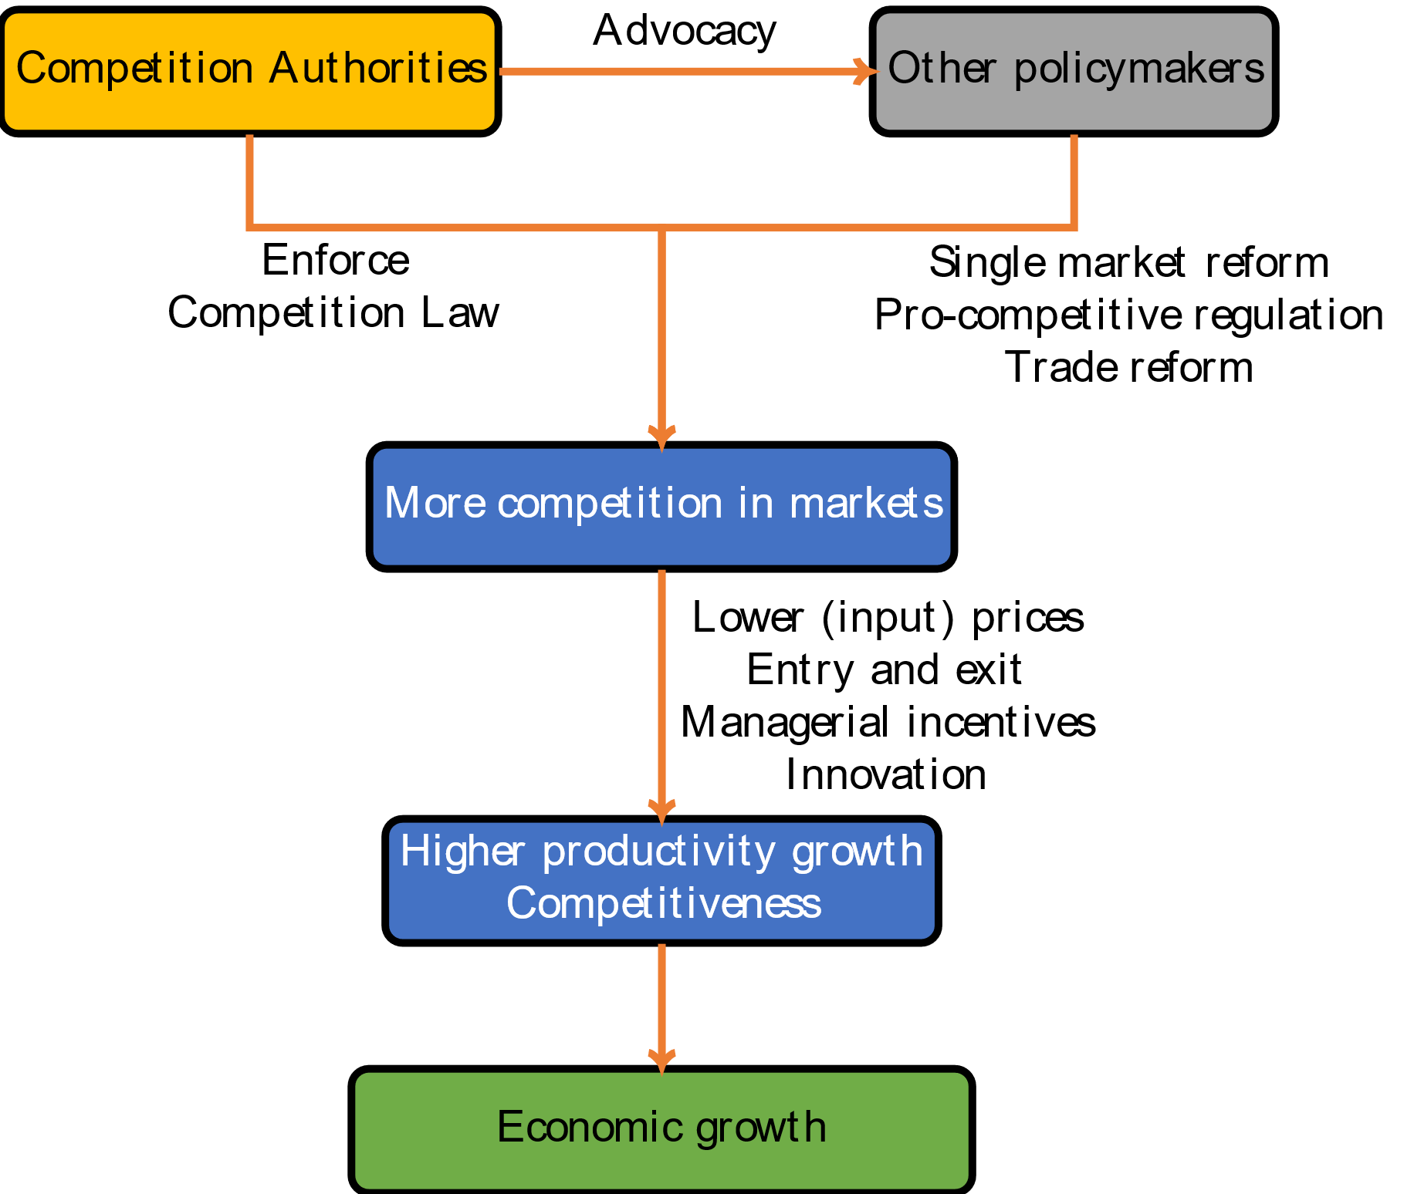
Why the evolution of competition matters
Strong + consistent economic evidence: effective competition lowers prices and strengthens productivity growth at sector level
Effective competition …
…forces firms to be more efficient
… (re-)allocates shares to more efficient firms; drives entry and exit
… forces firms to invest and innovate
Productivity growth across sectors is the main driver of an economy’s competitiveness and long term economic growth

Slide 7
Introduction
2022: Research plan and contracting
Background
Globally, indications of fundamental changes: concentration, markups and profits, business dynamism
Changes possibly linked to adverse macroeconomic trends: slow productivity growth, inequality, weak growth, …
Similar research in other jurisdictions: e.g. Germany, UK, Canada
Overall objective
Contribute economic evidence on (1) the evolution and (2) the importance of competition to the policy debates on (i) competition policy and (ii) EU competitiveness
2 OECD studies
Lear et al. study
In-house research
June 2024 Report: Protecting competition in a changing world
Part I: Evolution of competition
Concentration at industry and market level
Markups and profits
Business dynamism
Drivers of competition
Sectors at risk
Part II: Importance of competition for…
Prices/purchasing power
Productivity
(External) competitiveness
Economic growth

Slide 8
Approach of the report and limitations
Approach
Reputed external researchers from OECD + consortium of reputed academics and consultants => orthodox methods and results
Fill gaps in research on the EU
Methodological innovations and novel data sources
Combine diverse teams, research types, datasources => increases robustness, nuance
Link findings to enforcement
Timing: evidentiary input for strategy discussions for new mandate
Limitations
Measuring competition is challenging
Data limitations: (mostly) 2000-2019
Behind aggregate trends significant sector differences
Complements, but no substitute for (1) case by case enforcement or (2) ex post evaluation

Slide 9
Evidence on the evolution of competition in the EU from part I of the report

Slide 10
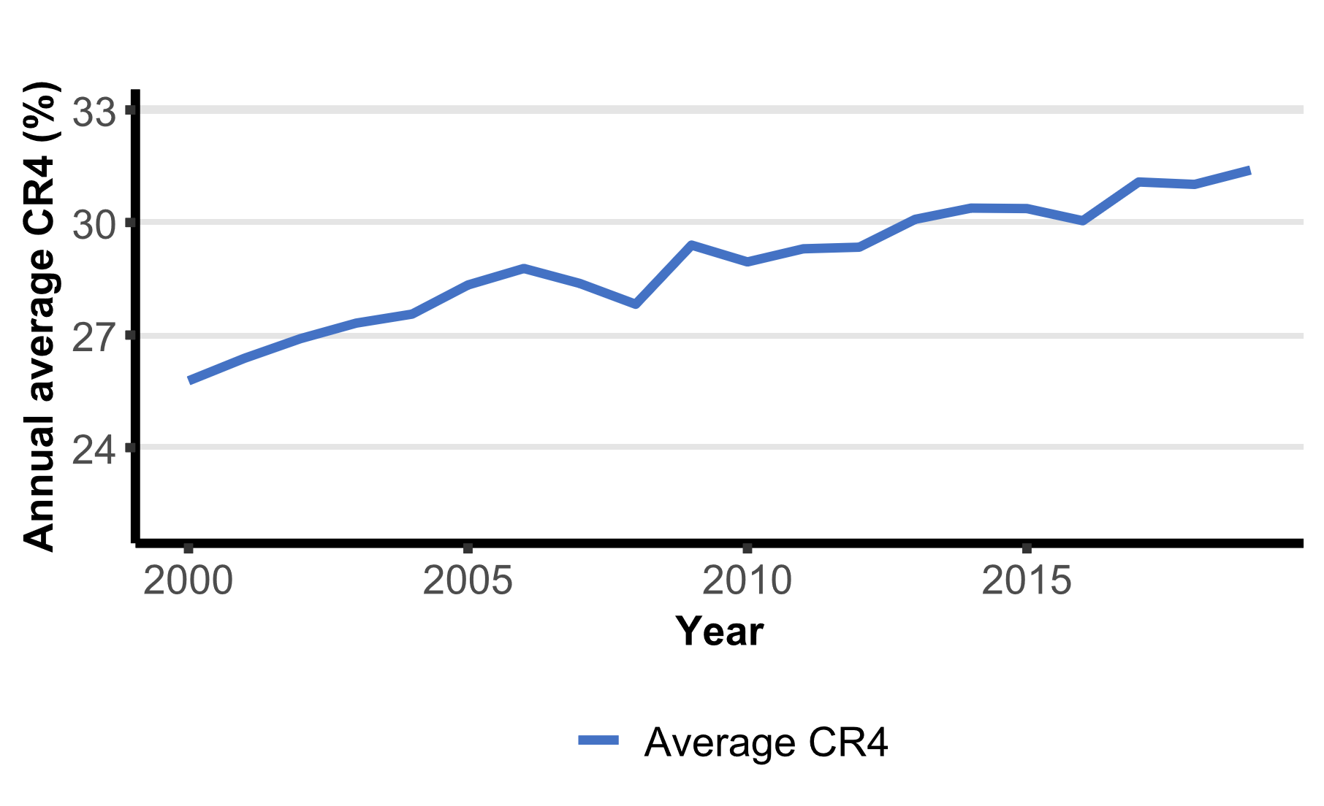
Industry concentration (1)
Measurement challenges:
NACE Industry sectors are broad
Production shares ≠ consumption shares
Geographic dimension of competition + multinationals
Innovations:
Tradeability of goods and services => sectors in 3 geographic buckets
Nace 3 and even 4 digit sectors
Linkages in same business group in Orbis
Main result: average industryCR4 increased by ~5 percentage points between 2000-2019 for a sample of 127 industries* across 15 countries (Fig. 1)
Figure 1: Industry concentration: CR4 2000-2019, aggregating across geographical ‘buckets’
Source: OECD (Calligaris et al., 2024)

Slide 11
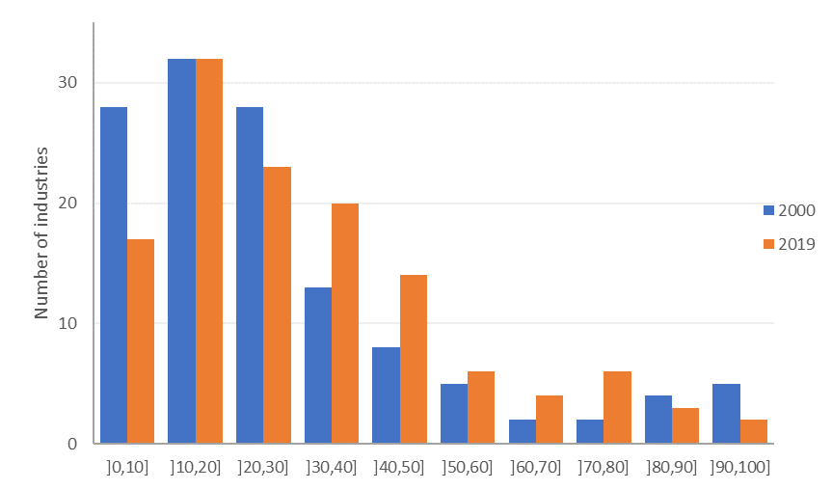
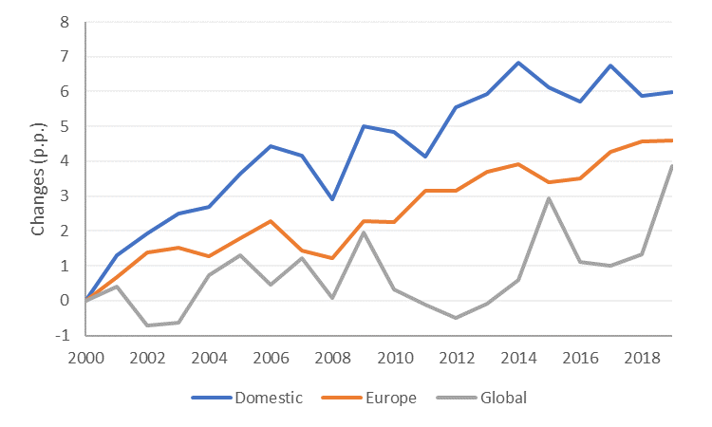
Industry concentration (2)
CR4 increased mostly in already concentrated sectors with industry CR4 30%-80% => trend towards oligopoly
Concentration levels and increases highest in industries competing at the national level. (Fig. 4).
Figure 2: Industry concentration – change in CR4 distribution, 2000 vs 2019
Figure 3: Industry concentration across geographical buckets, cumulative change (p.p., 2000-2019)
Source: OECD (Calligaris et al., 2024)
Source: OECD (Calligaris et al., 2024)

Slide 12
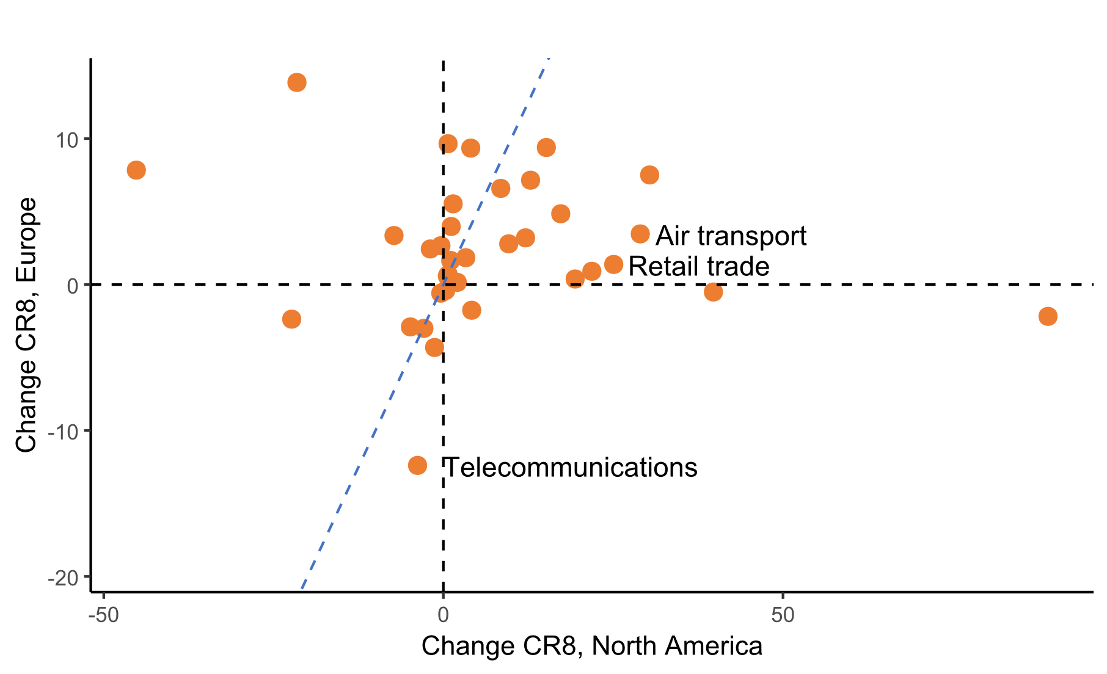
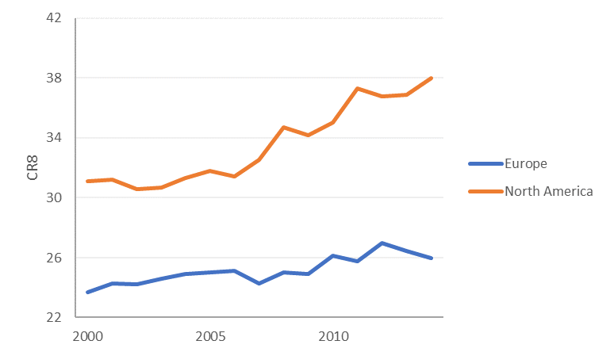
Industry concentration (3)
Prior work by OECD suggests that industry concentration is higher and grew more in the US than in the EU
Figure 5: Change in cumulative CR8 at the industry level, by economic zone (2000-2014)
Figure 4: Change in CR8 at the industry level (2000-2014)
Source: Bajgar et al. (2023), data from online appendix

Slide 13
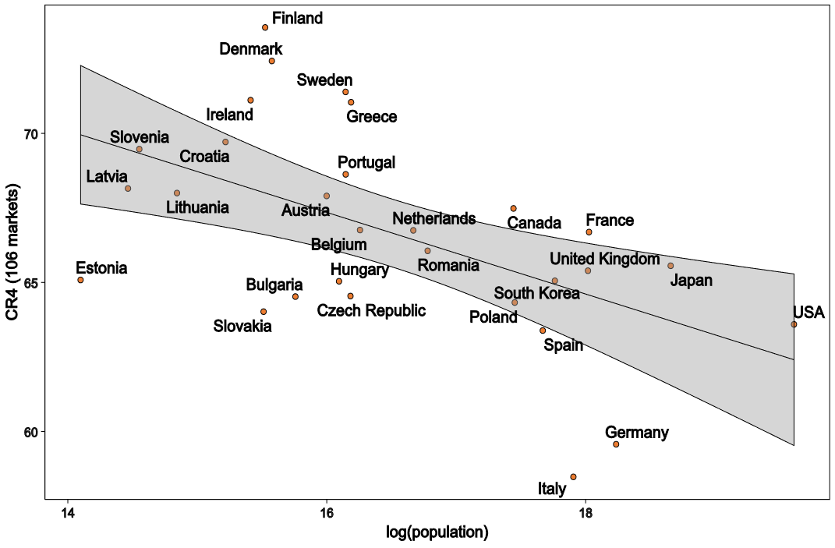
Market concentration (1)
Figure 6: The relation between CR4 (106 markets) and country population
New Euromonitor dataset: more than 300 consumer facing markets at level comparable to antitrust market; EU and
EU average CR4 > 60 %: significantly higher than at industry level
Significant differences between countries even when controlling for population (Fig. 2)
Data: Euromonitor International, in-house calculations

Slide 14
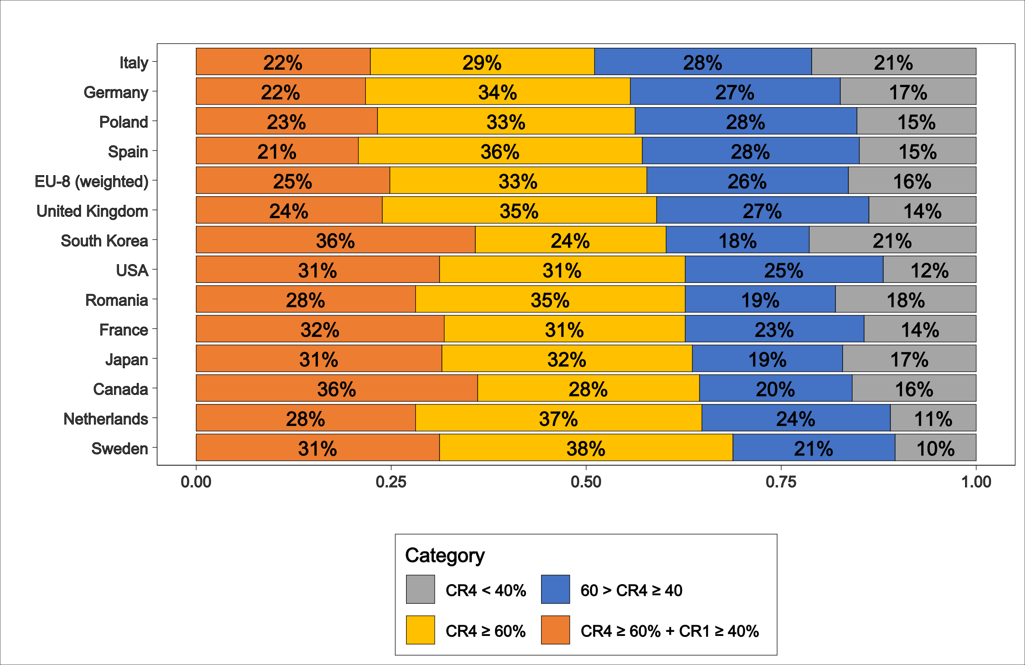
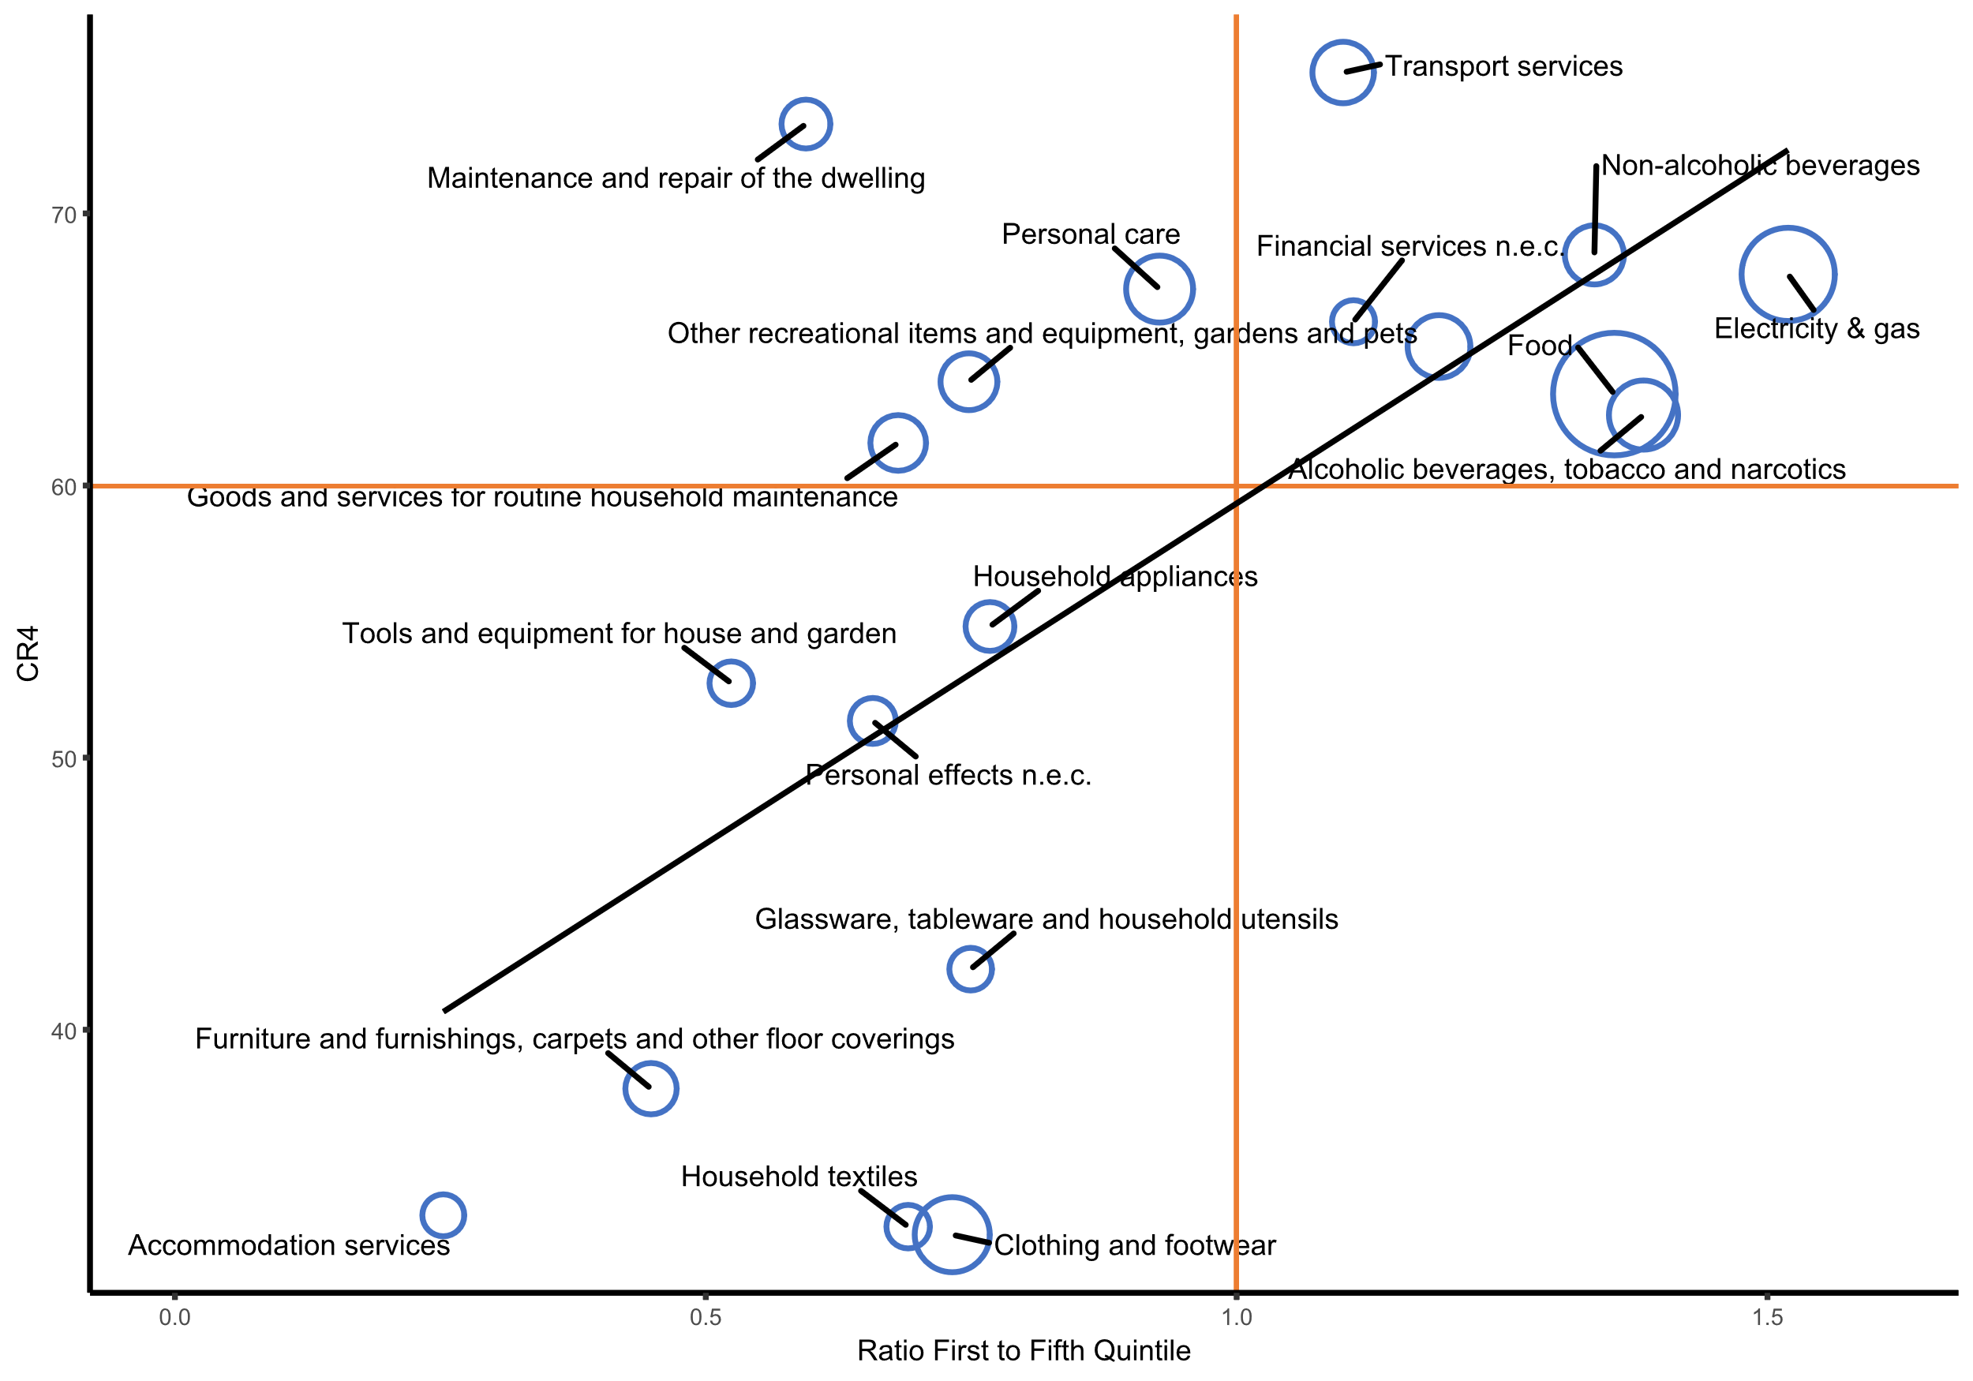
Market concentration (2)
More than 50% of consumer- facing markets are concentrated with CR4> 60%
Concentration highest in markets which matter for poor households: food, energy
Figure 7: Distribution of (325) markets by concentration levels (CR4; CR1)
Figure 8: Concentration and relative exposure, richest versus poorest European households, 2019

Slide 15
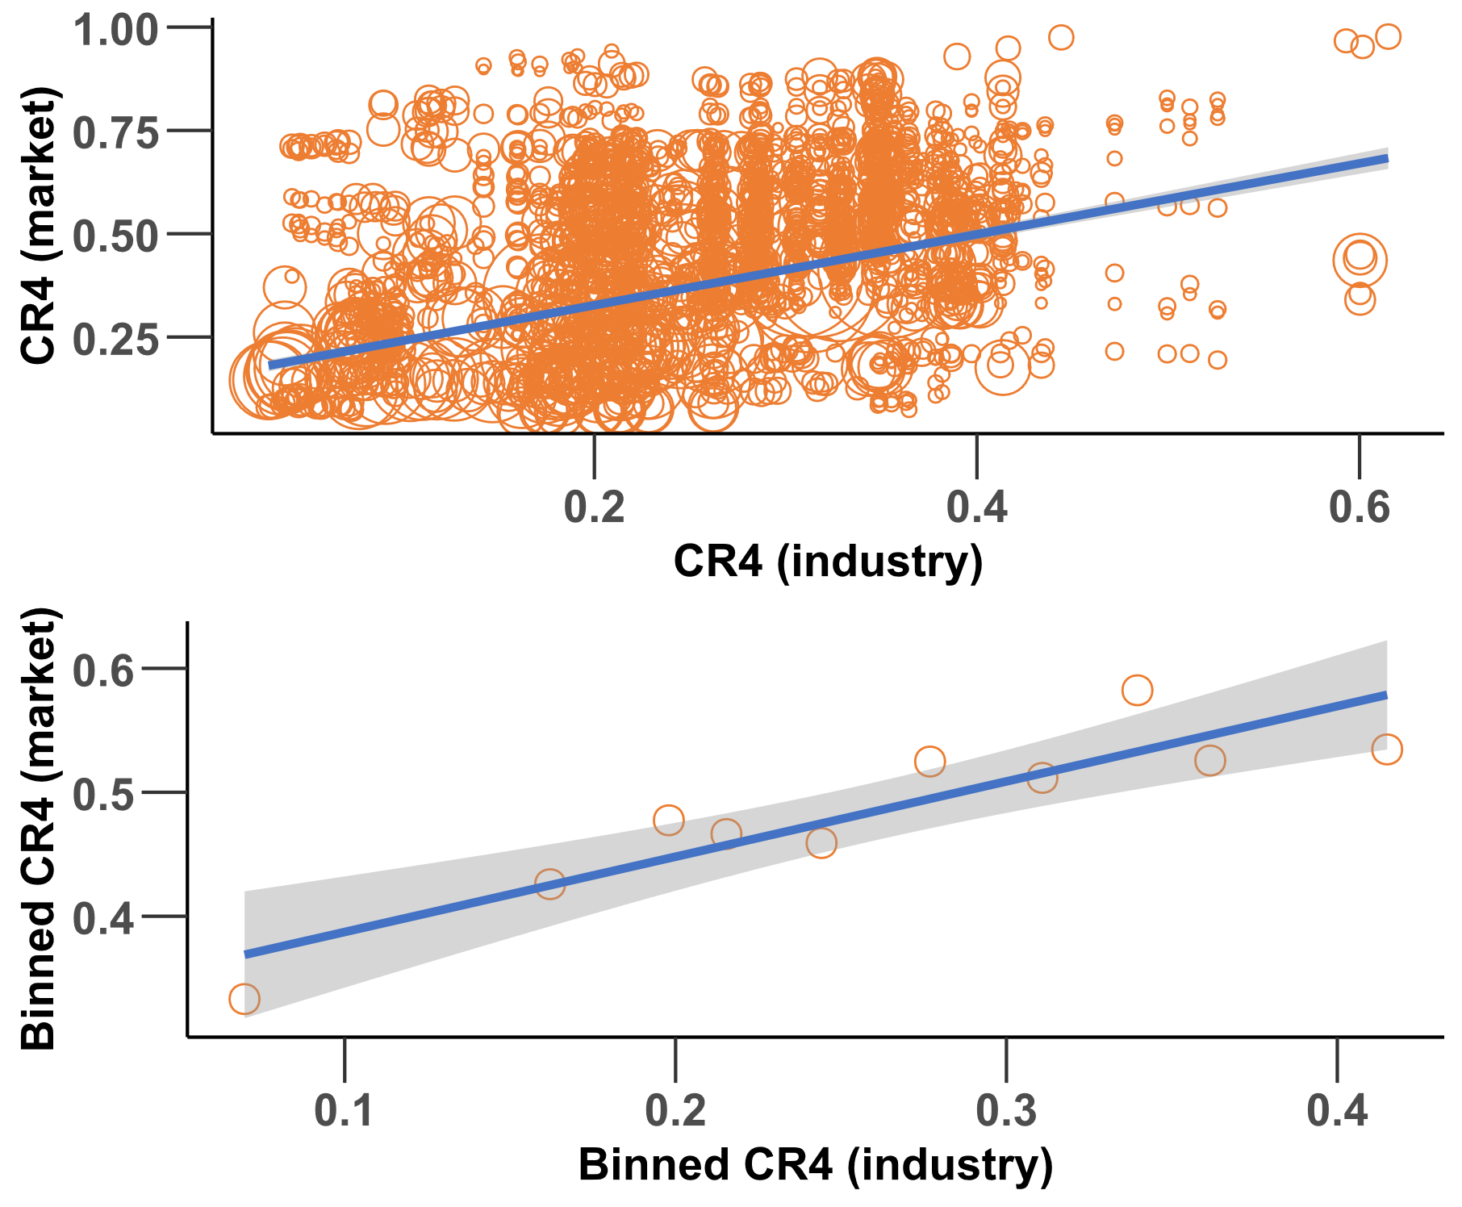
Industry concentration as measured in the report and market concentration are linked
Figure 9: The relation between market and industry CR4, weighted by market size (top), binned weighted average by decile of data (bottom)
Strong correlation between levels/trends in concentration at the product market and associated industry level (Fig. 7).
Concentration at the product market level usually significantly higher than at industry level
Trends in industry concentration matter, while industry concentration levels often understate likely product market concentration

Slide 16
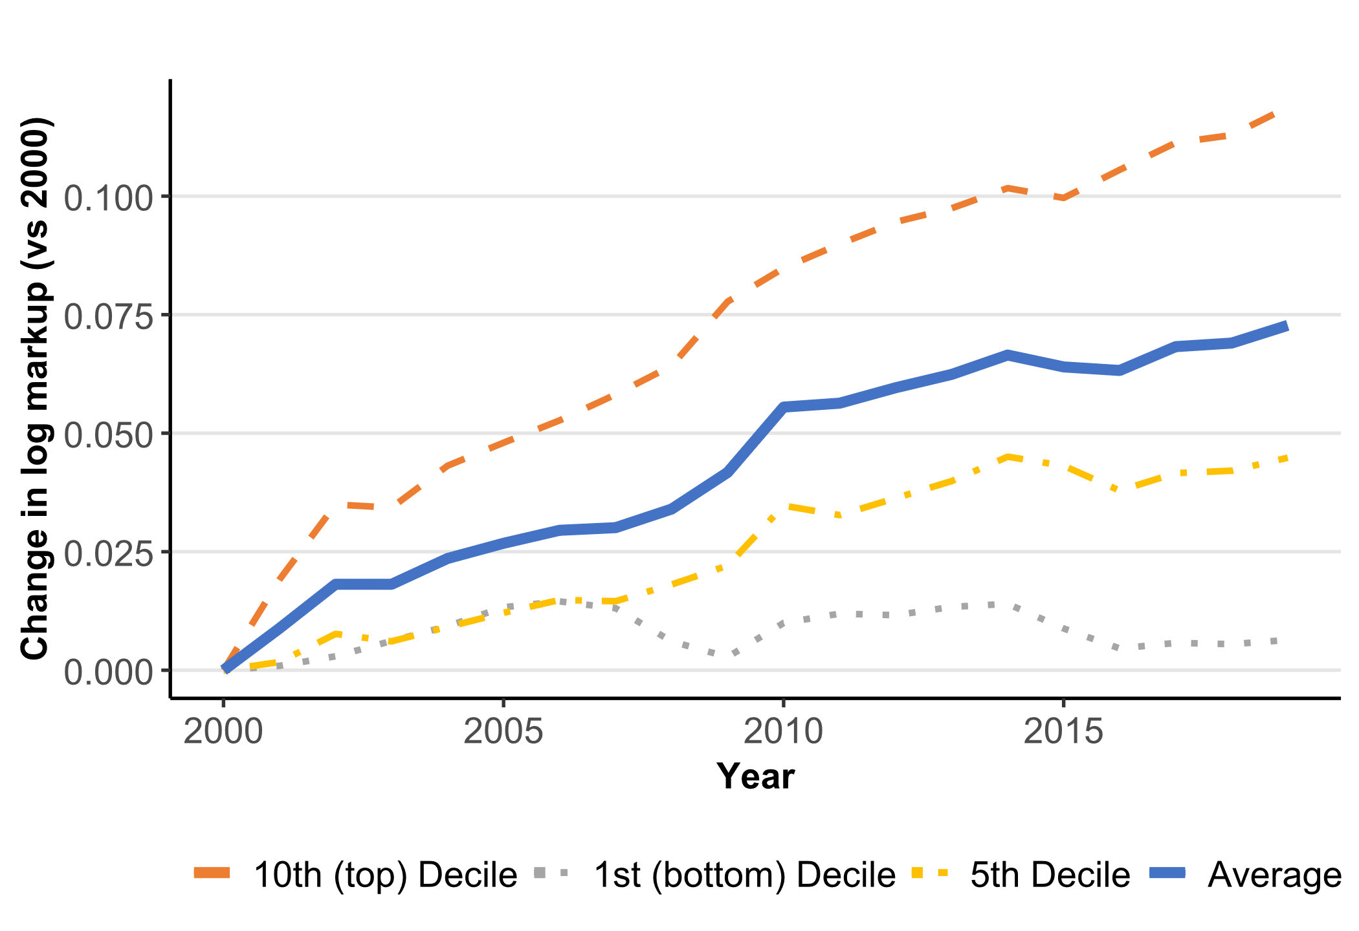
Markups
Figure 10: Growth of average firm level markup in different parts of the distribution (2000-2019)
Markup =
price/marginal cost
an indicator of market power
Average firm-level markups increased by ~7% between 2000 and 2019
Increase mainly driven by rising markups at the top of the markup distribution: increase of ~12% in top decile (Fig. 3).
The increases in markups primarily took place in (i) digitally intensive industries and (ii) services
Source: OECD (Calligaris et al., 2024)

Slide 17
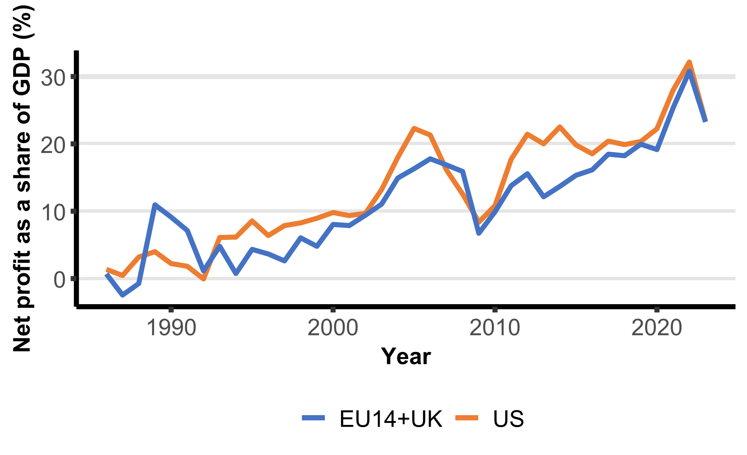
Profits (1)
The net profit share of GDP increased from ~2% to more than 20% between 1986 and 2023 in 15 European countries (Fig. 10)
Markups and profits are positively correlated suggesting that the rise of markups is not just driven by change in cost structures
Figure 11: Evolution of the net profit share of GDP EU vs. US
Source: Koltay et al. (2023), updated

Slide 18
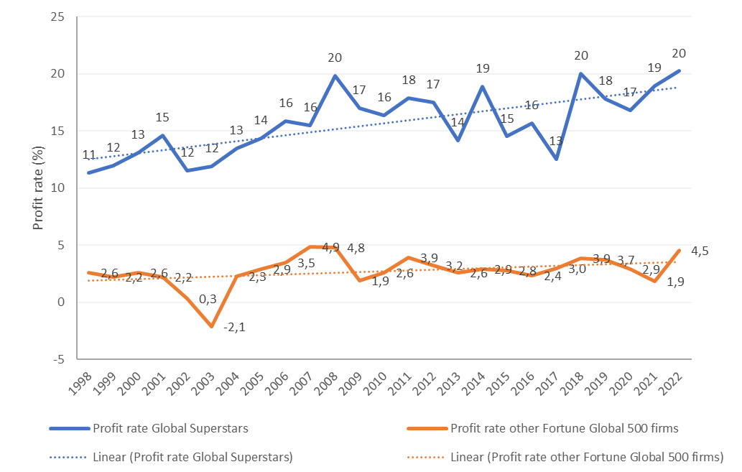
Profits (2): the rise of ‘global superstars’
Figure 12: Development of average profit rate of Global Superstars vs. other Fortune Global 500 firms
Profit rates of the 50 most profitable large global firms (‘Global superstars’) increased from ~11% to ~20% between 1998 and 2022
Profit rates rose not just for GAFAMs and semi-conductors, but also Pharma, FMCG, Oil&Gas, Retail
Low entry rates in Household + Personal care products, Pharma, Tobacco, Food= Beverages, Chemicals

Slide 19
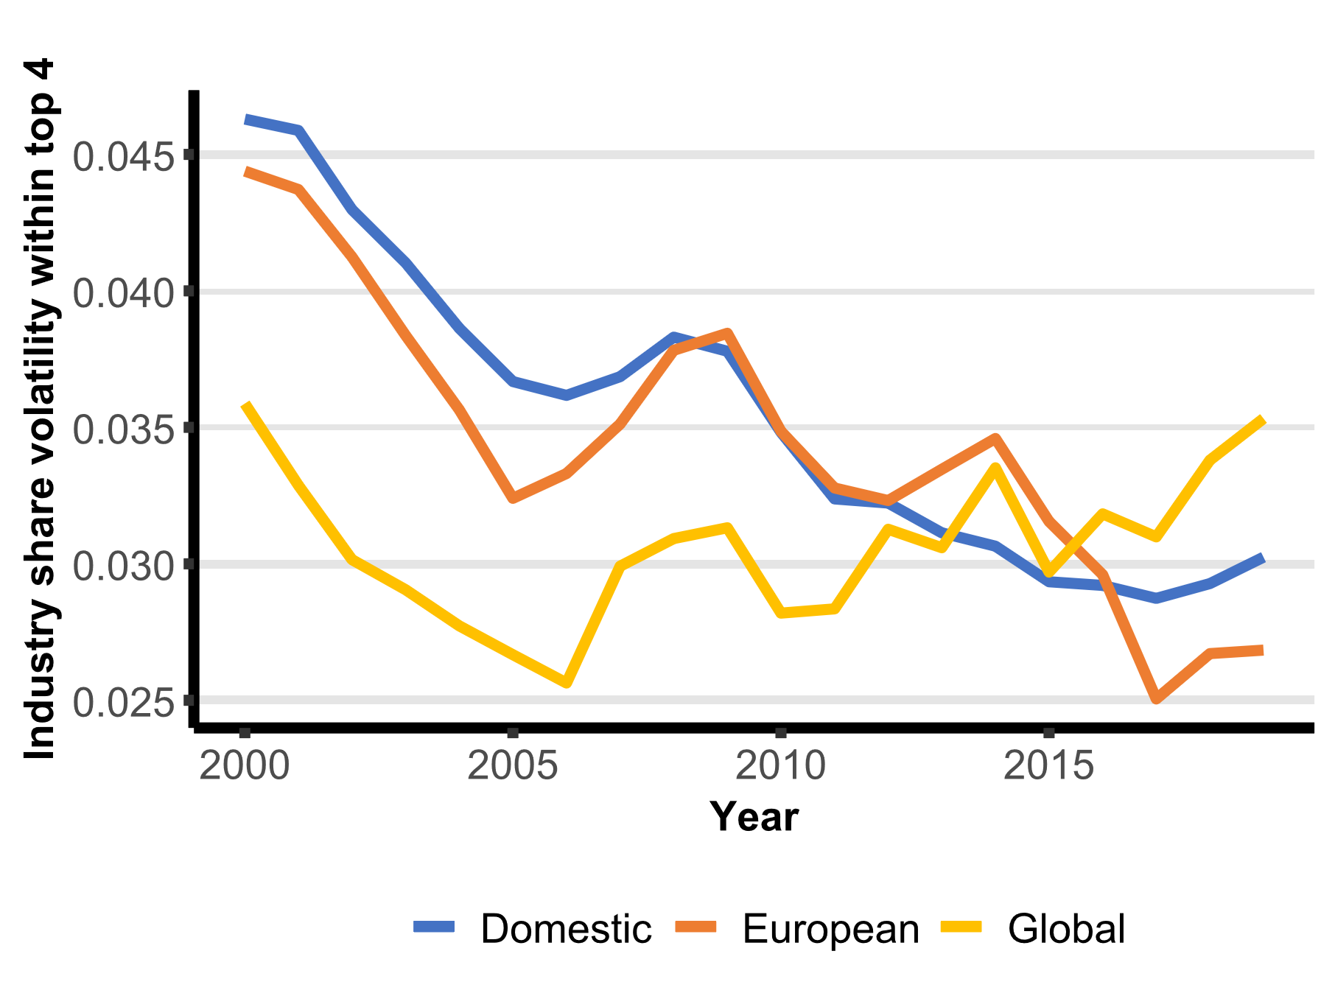
Business dynamism
Figure 13: Industry share volatility across
geographical buckets (2000-2019)
Less disruption amongst leaders (fig. 5)
Growing gap between leaders and followers as regards markups, profits and productivity growth:
less diffusion of innovation and productivity improvements
increasingly a ‘two-speeds’ economy
Less entry and exit of firms
Source: OECD (Calligaris et al., 2024)

Slide 20
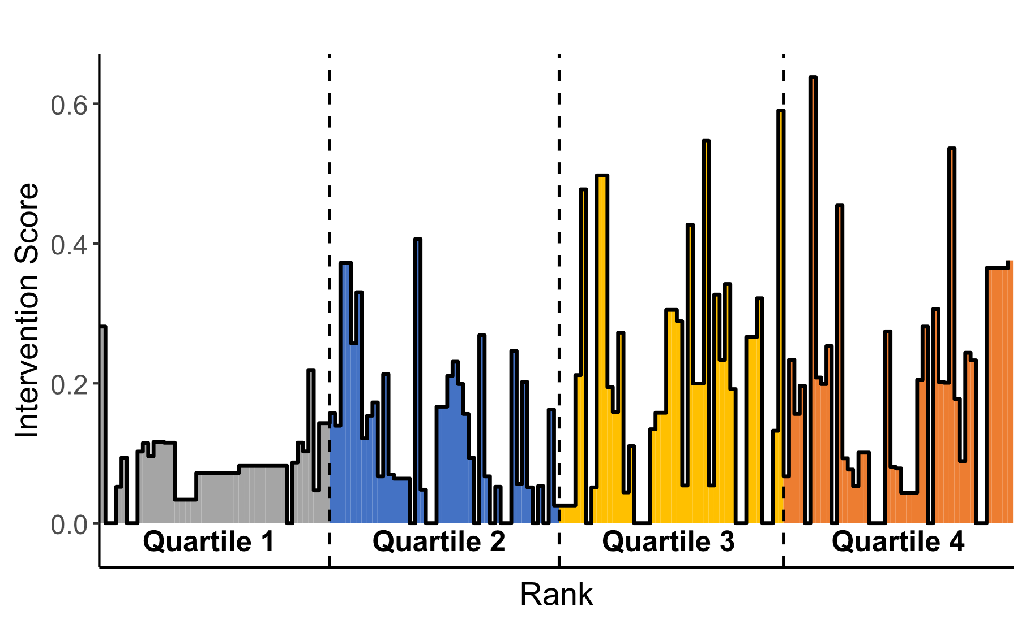
Sector competition risk vs. enforcement
Ranking of 127 industry sectors according to their competition risk
Sectors with high competition risk include e.g.:
Manufacture and distribution of gas (#127)
Telecommunications (#126)
Manufacture of air and spacecraft (#119)
EU competition interventions in merger control (Fig. 6) and antitrust are more frequent in sectors with higher competition risks
Figure 14: Merger intervention score by sector rank
Source: DG. Comp, OECD (Abele et al., 2024)

Slide 21
Main drivers and balance of effects
Technological change (software) + other intangibles (patens, brands)
Globalisation
Regulatory barriers to entry | ?
Rise of M&A/ underenforcement | ?
Largely structural changes over the past 25 years => both benign (efficiencies) and adverse (concentration, market power, barriers) effects on competition
Sector heterogeneity as regards direction and mix of drivers
On balance and on average, competition in the EU today is likely weaker and market power more pronounced than in the past
The observed changes in the nature and intensity of competition may have contributed to (i) lower business dynamism, (ii) slower productivity growth, (iii) decline of labour share, (iv) lower resilience to shocks

Slide 22
Evidence on the importance of competition from part II of the report

Slide 23
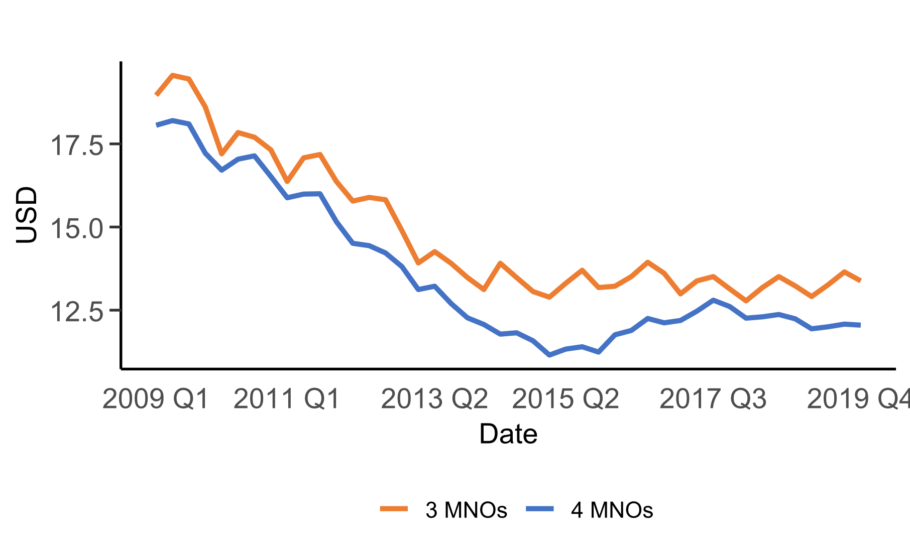
Impact of competition on prices: new price- concentration study
Figure 15: Evolution of ARPU (average revenue per unit/user) in European countries based on the number of MNOs (mobile network operators).
For mobile telecoms and airlines markets:
Empirical evidence that higher concentration levels are associated with higher prices (Fig. 7)
EU prices significantly lower than in the US
For mobile telecoms higher concentration levels were not associated with higher investments
Source: Lear et al. (2024)
See also Elliott et al. JPE (2024, forthcoming)

Slide 24
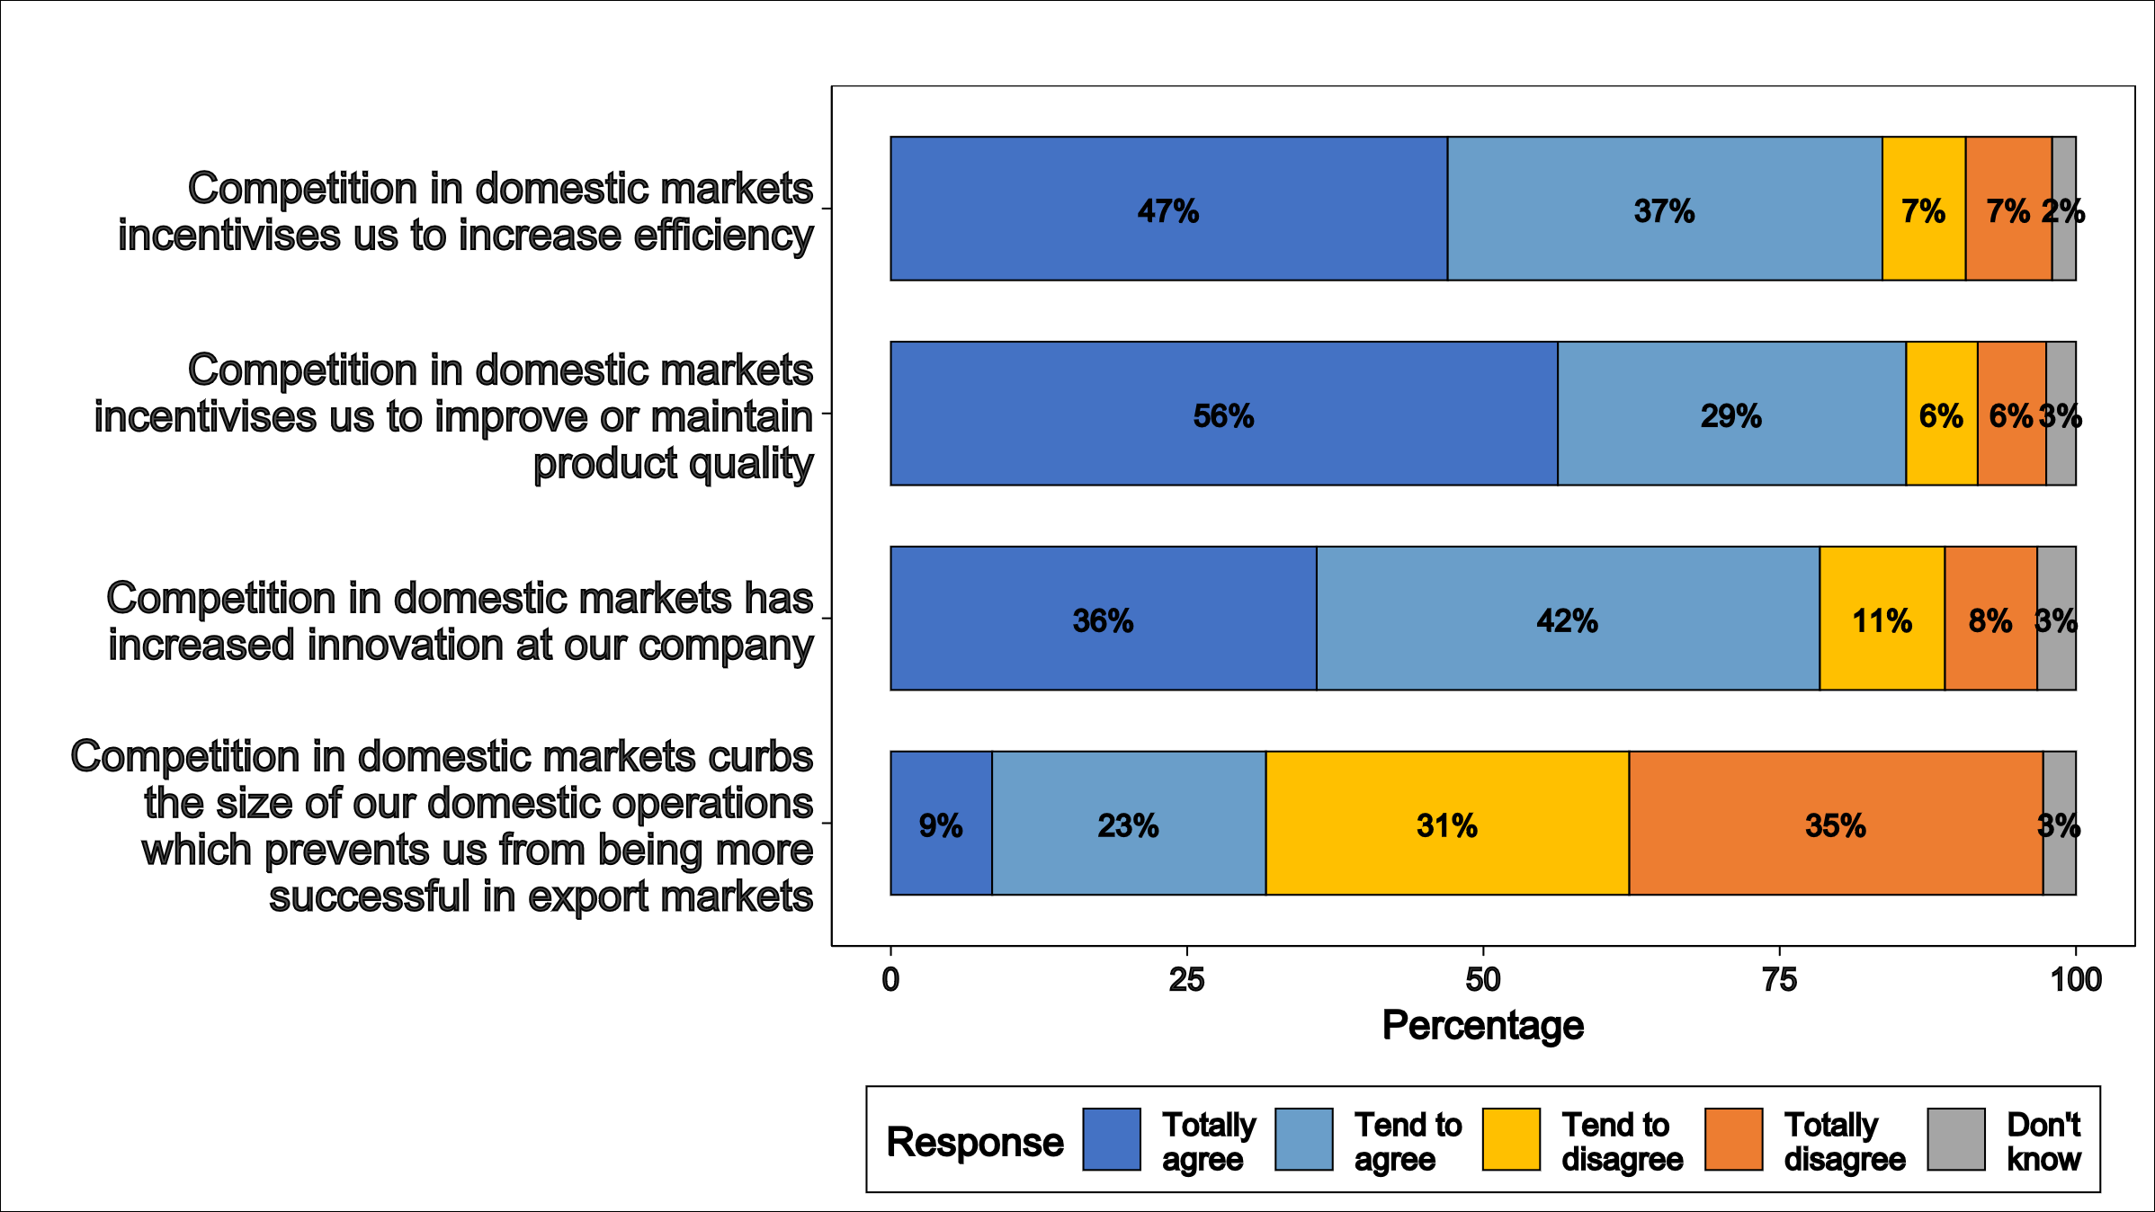
Impact of competition on competitiveness: new survey of EU exporting firms
Large majority of respondents confirms importance of domestic competition in input markets (goods and services)
Large majority of respondents confirms importance of domestic competition in exporting firms’ own markets (Fig. 8 first three lines)
A majority of respondents disagrees that competition curbs the size of their domestic operations hindering success on export markets (Fig. 8 last line)
Figure 16: Impact of domestic competition in exporting firms’ own markets
Source: Lear et al. (2024)

Slide 25
Impact of competition on growth: new macroeconomic simulation study
Study on the macroeconomic effects of competition: simulations of three hypothetical scenarios relying on an established macroeconomic model
Backward-looking simulation: the increase in markups observed in the EU since 2000 may have reduced EU GDP by up to 5 - 7% compared to the counterfactual. Without the Commission’s merger and antitrust interventions this impact might have been larger by almost one quarter
Two forward-looking simulations: (1) measures limiting the market power of firms at the top of the markup distribution (“trimming scenario”) or (2) pro-competitive reforms across the EU (“convergence scenario”) might each increase GDP by up to 2 - 4 %, depending on the time horizon

Slide 26
Implications for policy

Slide 27
Does the EU need less or more competition?
Increased concentration
Increased markups/profits
Decreasing disruption
at the top
by challengers/entrants
Growing gap between leaders and laggards as regards markups, profits, productivity
EU falls behind globally in terms of productivity growth + competitiveness
EU needs more, not less, competition
Purchasing power of consumers
More and better jobs
More disruption
at the top
by challengers and entrants
Resilience
supply chains
shocks
Boost to productivity and innovation (within firms)
Faster reallocation of resources between firms
Stronger incentives for private investment

Slide 28
Implication for EU competitiveness policies
Strengthening competition = key pillar of the overall competitiveness strategy
The EU’s main global rivals US and China also rely on effective competition as a fundamental driver/pillar of their competitiveness strategies
1. Pro-competitive regulatory reforrm
Regulatory/bureaucratic barriers to entry/exit
Whole of government approach to competition ?
5. Ambitious and robust trade policy keeping markets open
2. Single market reform boosting scale and competition
Energy, Finance, Telecoms
Services
4. A pro-competitive industrial policy
Boosts contestability where possible
Does not distort competition further
3. Effective competition policy enforcement supportive of competitiveness (next slide)

Slide 29
Implications for competition policy
Higher concentration, markups, profits entrenchment; growing gap between leaders and followers => independently of causes, likely (1) higher competition risk affecting (2) more sectors
Be even more vigilant than in the past
Continue to evolve and adapt to changing environment (1) more markets with oligopoly and single firm market power, (2) contestability, (3) dynamic competition and innovation
Continue with fact based enforcement + smart remedies as efficiencies may be (sometimes) real
Need to equip competition authorities with resources and tools adapted to the increased competition risks/speed/complexity
While underenforcement likely not a main driver of the observed trends, continue ex post evaluation and permanent improvement
Contestability, diffusion of innovation and dynamic competition at least as important as price competition
Increasing speed of change and increasing complexity of markets
How can we boost competition and preserve the benign effects/efficiencies?

Slide 30
Thank you
© European Union 2023
Unless otherwise noted the reuse of this presentation is authorised under the CC BY 4.0 license. For any use or reproduction of elements that are not owned by the EU, permission may need to be sought directly from the respective right holders.
Notes:
Update/add/delete parts of the copy right notice where appropriate.
More information: https://myintracomm.ec.europa.eu/corp/intellectual-property/Documents/2019_Reuse-guidelines%28CC-BY%29.pdf

